Slide 1


Introduction to Python
Katowice, IntQuant 2025
March 17, 2025

Slide 2
Agenda
Introduction: why Python?
Python: 15 mins course
Data: pandas
Regression: scikit-learn
Visualization: matplotlib

Slide 3
Section 1
Introduction: why Python?

Slide 4
Introduction: why Python?
Why Python?
https://www.python.org/
Materials
Introductory: https://www.py4e.com/, https://www.tutorialspoint.com/python/index.htm
Advanced: Fluent Python by Luciano Ramalho
Programming environment
Anaconda
https://www.anaconda.com/
conda

Slide 5
Section 2
Python: 30 minutes course

Slide 6
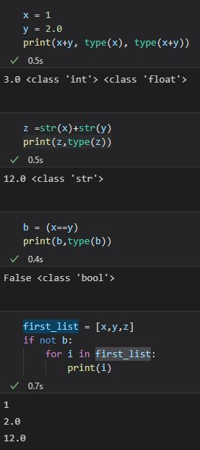
Python: 15 minutes course
Data Types and Operators
Basic types: str, int, float, bool
Containers: list, dict, set
Arithmetic operators: +, -, *, /, **
Logical operators: ==, !=, >, <, <=, >=
Control Flow
if condition
for loop

Slide 7
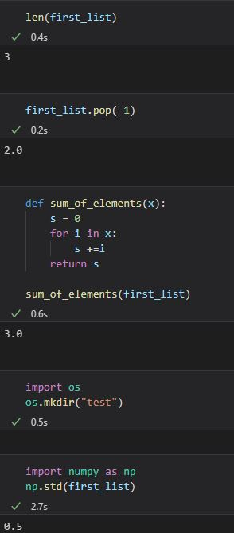
Python: 15 minutes course
Functions
built-in functions
methods
def key word
Modules
import statement
Python standard library
Externals modules: numpy

Slide 8
Section 3
Data: pandas

Slide 9
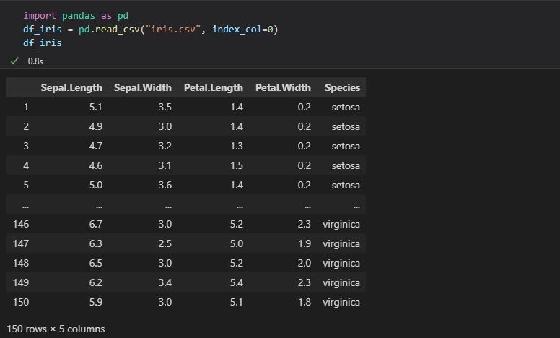
Data: pandas
https://pandas.pydata.org/

Slide 10
Section 4
Regression: scikit-learn

Slide 11
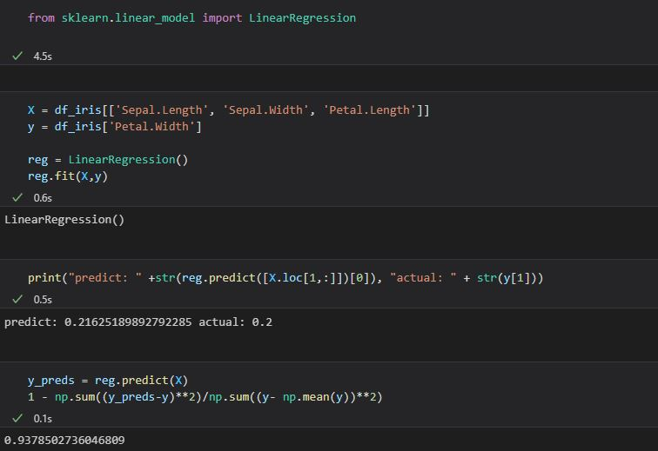
Regression: scikit-learn
https://scikit-learn.org/stable/

Slide 12
Section 5
Visualization: matplotlib

Slide 13
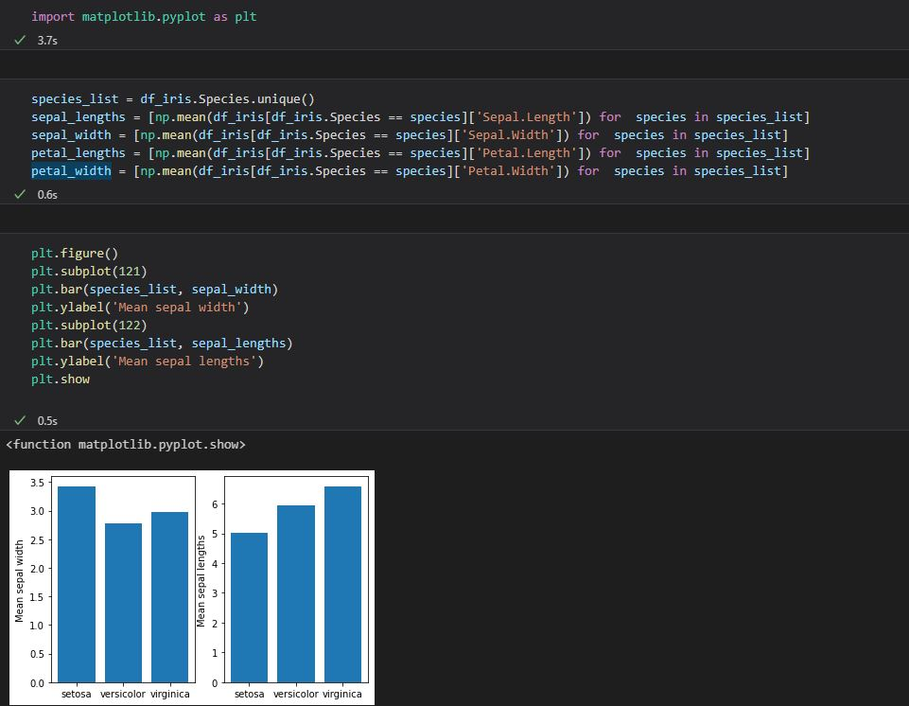
Visualization: matplotlib
https://matplotlib.org/

